Slide 1


Change Management in
Legacy Modernization
Vasudha Prabhala
Senior Vice President -
Service Delivery
Headspring
Kari Brey Second Vice President -
Information Technology
Travelers

Slide 2

Legacy Modernization
An information system that is critical to day-to-day operations, but is based on outdated technologies
Skills shortage and aging workforce
Loss of application knowledge
May require re-engineering of business processes
Notes:
5:00
Communication is part of everyday life. It helps create and deepen our connection with others. It improves teamwork and problem-solving.
Yet, all too often, true communication with others fails.
Then why is it hard? Everybody has their own way of communicating, It is influenced by cultural backgrounds, temperament and various other aspects
If it is such an essential part of who we are, so why is communication so difficult?
We feel unheard and disrespected.
They feel unheard and disrespected.

Slide 3
“The process of continually renewing an organization’s direction, structure, and capabilities to serve the ever-changing needs of external and internal customers”
Notes:
What is change management?

Slide 4

Why do change management initiatives fail?
Flawed understanding of roots of resistance
Change isn’t measured (emotions aren’t measured)
Change management isn’t tied to business results
Too much focus on big bang changes than incremental changes
Initiatives are more focused on selling the change than engaging people on the change
Treating transformation as a program and not as a learning organization
Notes:
Managing change is difficult and the sad truth is that most transformational change initiatives fail. The reasons for this poor performance are that organizational resistance is grossly underestimated and that “change agents” believe that change can be managed somehow and leads to faulty interventions . If the Dynamics of change cannot be predicted with certainty, measured or controlled then you truly do not know what you are managing change

Slide 5

Unintended Consequences
Job satisfaction
Organizational burnout
Delivery performance
Negative User experience
Notes:
Managing change is difficult and the sad truth is that most transformational change initiatives fail. The reasons for this poor performance are that organizational resistance is grossy underestimated and that “change agents” believe that change can be managed somehow and leads to faulty interventions . If the Dynamics of change cannot be predicted with certainty, measured or controlled then you truly do not know what you are managing change

Slide 6
“The key to successful change is measuring and understanding the right things with a focus on capabilities - not on maturity”
Notes:
While maturity models are very popular in the industry, we cannot stress enough that maturity models are not the appropriate tool to use or mindset to have. Instead, shifting to a cpabilities model of measurement is essential for organizations wanting to accelerate software delivery.

Slide 7
Change Management

Slide 8
Steps to get better at change management
1
Choose your direction
2
Develop change leaders
3
Make culture a priority
4
Expand iteratively
5
Focus on capabilities over technologies
6
Measure the change
Notes:
5:00
Communication is part of everyday life. It helps create and deepen our connection with others. It improves teamwork and problem-solving.
Yet, all too often, true communication with others fails.
Then why is it hard? Everybody has their own way of communicating, It is influenced by cultural backgrounds, temperament and various other aspects
If it is such an essential part of who we are, so why is communication so difficult?
We feel unheard and disrespected.
They feel unheard and disrespected.

Slide 9
Choose Your Direction
Choose ONE direction and stay the course
Seek 360 Stakeholder buy-in
Identify the enablers and derailers
Anticipate disruptions and develop mitigation strategies
Notes:
The right quest should be a compelling and uncontested priority. In some of the cases we analyzed, companies straddled quests (customer focus and agility, for instance, or innovation and sustainability). That can work as long as the components are fused into one cogent focus.
Studies and analysis that we have conducted show that most corporate transformation efforts are either derivatives or combinations of five prototypical quests:
Global presence: extending market reach and becoming more international in terms of leadership, innovation, talent flows, capabilities, and best practices
Customer focus: understanding your customers’ needs and providing enhanced insights, experiences, or outcomes (integrated solutions) rather than just products or services
Nimbleness: accelerating processes or simplifying how work gets done to become more strategically, operationally, and culturally agile
Innovation: incorporating ideas and approaches from fresh sources, both internal and external, to expand the organization’s options for exploiting new opportunities
Sustainability: becoming greener and more socially responsible in positioning and execution

Slide 10
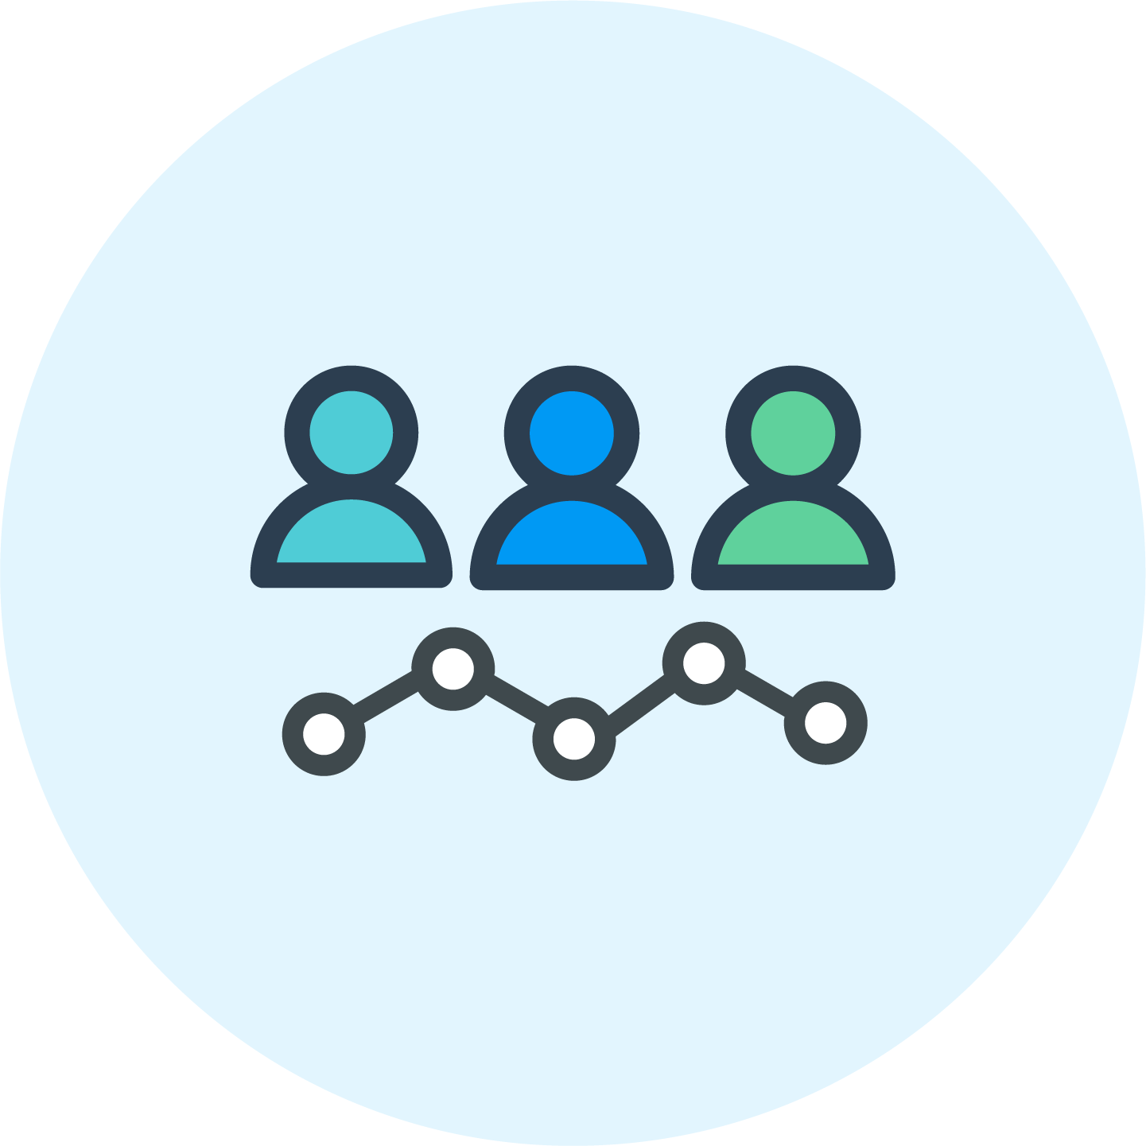
Develop Change Leaders
Change leaders are more than end users
Invest in champions at every level
Develop reinforcement loops
Inspire others to high performance
Notes:
The right quest should be a compelling and uncontested priority. In some of the cases we analyzed, companies straddled quests (customer focus and agility, for instance, or innovation and sustainability). That can work as long as the components are fused into one cogent focus.
Studies and analysis that we have conducted show that most corporate transformation efforts are either derivatives or combinations of five prototypical quests:
Global presence: extending market reach and becoming more international in terms of leadership, innovation, talent flows, capabilities, and best practices
Customer focus: understanding your customers’ needs and providing enhanced insights, experiences, or outcomes (integrated solutions) rather than just products or services
Nimbleness: accelerating processes or simplifying how work gets done to become more strategically, operationally, and culturally agile
Innovation: incorporating ideas and approaches from fresh sources, both internal and external, to expand the organization’s options for exploiting new opportunities
Sustainability: becoming greener and more socially responsible in positioning and execution

Slide 11

Make Culture A Priority
Start with end state culture and map the gaps
Build a learning driven culture
Share successes and learnings in a transparent manner
Over-communicate
Adopt a blameless post mortem attitude - It's the what and why, not the who

Slide 12

Expand Iteratively
Share consumable bites
Make continuous delivery a mindset
Embrace Continuous improvement
Experiment in thin slices

Slide 13
Focus on capabilities
Identify and agree on the capabilities necessary to be successful
Assess skills-at-hand versus skills -to- be developed
Adopt willing, able and ready strategy
Learn from others mistakes

Slide 14

Measure Change
Measure every stakeholder group for culture and direction
Measure where you want to impact
Correlate software development metrics directly to business outcomes
Notes:
End users - NPS
Development team - velocity, estimation variance
Employment engagement - burn out, team morale

Slide 15
In summary, for better change management outcomes
1
Choose your direction
2
Develop change leaders
3
Make culture a priority
4
Expand iteratively
5
Focus on capabilities over technologies
6
Measure the change
Notes:
5:00
Communication is part of everyday life. It helps create and deepen our connection with others. It improves teamwork and problem-solving.
Yet, all too often, true communication with others fails.
Then why is it hard? Everybody has their own way of communicating, It is influenced by cultural backgrounds, temperament and various other aspects
If it is such an essential part of who we are, so why is communication so difficult?
We feel unheard and disrespected.
They feel unheard and disrespected.

Slide 16
Thank You

